Slide 1
Full Structural Models
Examples

Slide 2
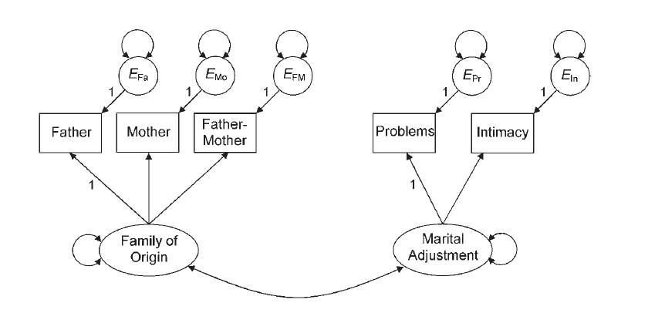
Full SEM Traditional Variables
Kline_9_family

Slide 3
Full SEM – Traditional – Import Data
For this example, we have a correlation table:
Import the data
Include the SDs
Name everything
Covert to covariance

Slide 4
Full SEM – Traditional – Define Model
First, we are going to test the measurement model – just the CFAs with a covariance between them (double headed arrow in that picture).
Then, we are going to change it to a full SEM, predicting the direction of the relationship between latents.
NOTE: the measurement loadings should not change much.

Slide 5
Full SEM – Traditional – Uh oh!
This model (for whatever reason), doesn’t want to run with cov table.
Look at the error by using:
inspect(model fit, “cov.lv”)
inspect(model fit, “cor.lv”)
Let’s use the correlations to run this data.
Use family to predict

Slide 6
Full SEM – Traditional – Run and Interpret
Run model, get output, draw pictures
Interpret:
Heywood cases:
Variances, Rsquares
Parameters
Residuals
Modification Indices
Fit Indices

Slide 7
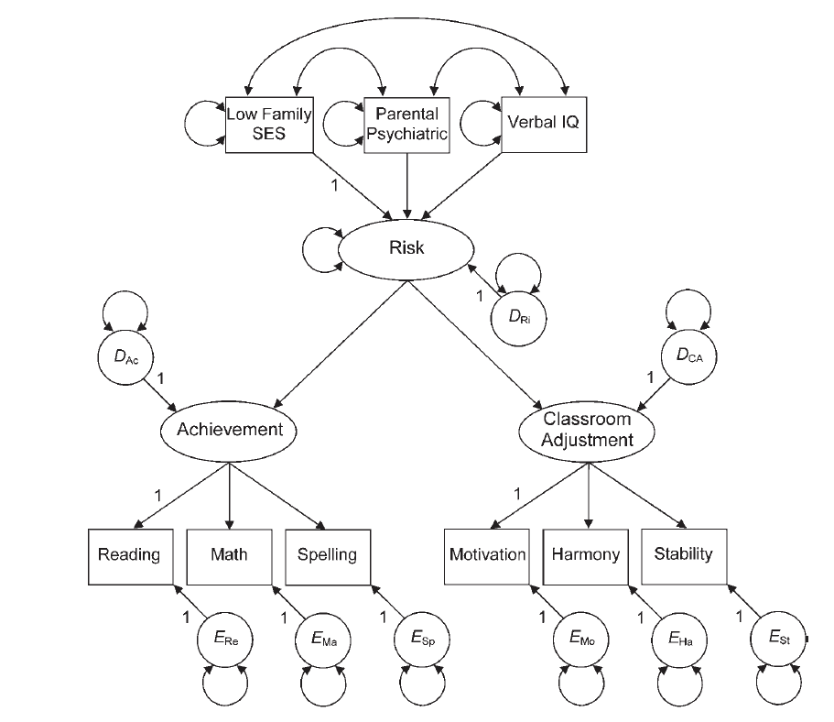
Full SEM Composite Variables
Kline 10 risk

Slide 8
Full SEM – Composite – Import the Data
For this example, we have a correlation table:
Import the data
Include the SDs
Name everything
Covert to covariance
(and this one will run ☺)

Slide 9
Full SEM – Composite – Define Model
How to define a composite variable?
We have been using =~ to define a latent variable that predicts manifest variables.
Use <~ to create a composite variable that is predicted by the manifest variables.

Slide 10
Full SEM – Composite – Run and Interpret
Run model, get output, draw pictures
Interpret:
Heywood cases:
Variances, Rsquares
Parameters
Residuals
Modification Indices
Fit Indices

